Slide 1

Parkinson’s Disease Severity Prediction
Presented by:
Appidi, Harinadh
Kasturi, Aditya Karthikeya

Slide 2
Overview
01
02
03
04
05
Introduction
Related Work
Data Setup
Modeling
Results

Slide 3
01 Introduction

Slide 4
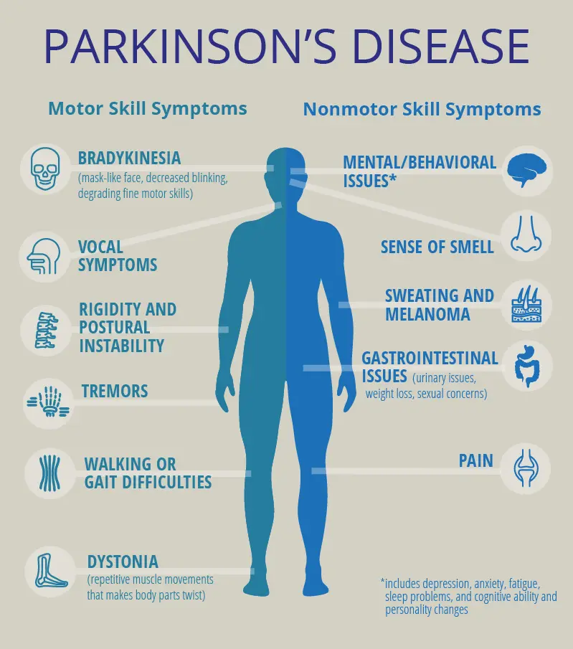
Introduction
Parkinson disease is a neurodegenerative disorder that leads to shaking, stiffness, and difficulty with balance and coordination.
It is the second most common neurodegenerative disorder after Alzheimer’s
There is no specific test for Parkinson’s Disease, so it can be difficult to diagnose
Main Symptoms of PD are tremor, rigidity and other movement disorders.
Vocal impairment is also a common symptom prevalent at the onset of disease.

Slide 5
Problem
Unified Parkinson Disease Rating Scale (UPDRS)
Requires physically in hospital for diagnosis
Limited methods and Frequent Visits

Slide 6
Solution
Telemonitoring
Intel's AHTD records patient's speech while they are describing static photographs displayed on screen.
Sustained vowel phonation's are used for assessing speech quality with the help of 16 voice measures.
Voice signals are processed using signal processing algorithms and measures are noted .
Features are to be extracted from these voice measures and to be mapped to UPDRS values.

Slide 7
02
Related Work
Who did it before?

Slide 8
Related Work
Previous Work by:
Athanasios Tsanas, Max A. Little, Patrick E. McSharry, Lorraine O. Ramig
Parsimonious model with a robust feature selection algorithm namely Lasso, CART.
Mean Absolute Error(MAE) is used as a metric.
Test MAE of 7.5 for Total UPDRS and 5.8 for Motor UPDRS.

Slide 9
03
Data and Setup
Lets Talk Data!

Slide 10


Data
Dataset Description
31.84.%
Female
68.16%
Male
Frequency of Participants ratio
5875 22 42 6
Observations Attributes Participants Duration

Slide 11
Data Cleaning and Assumptions
The patients did not receive any medication during the trail of six months.
UPDRS are linearly interpolated using assessments at baseline, after 3 months and after 6 months.
12 Samples with negative test times are removed from dataset.

Slide 12
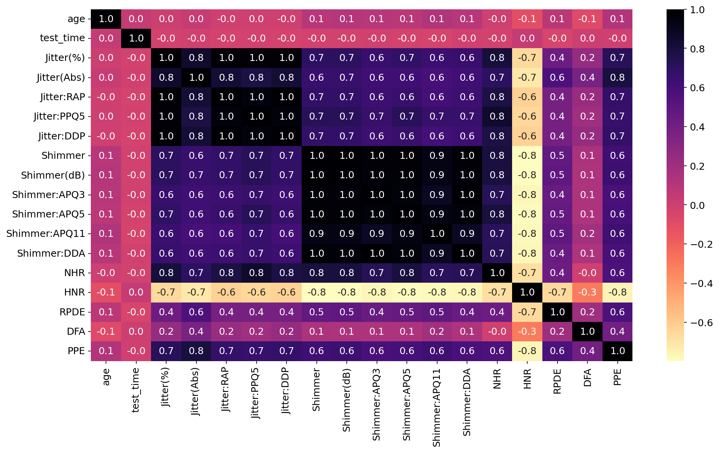
Correlation Plot

Slide 13
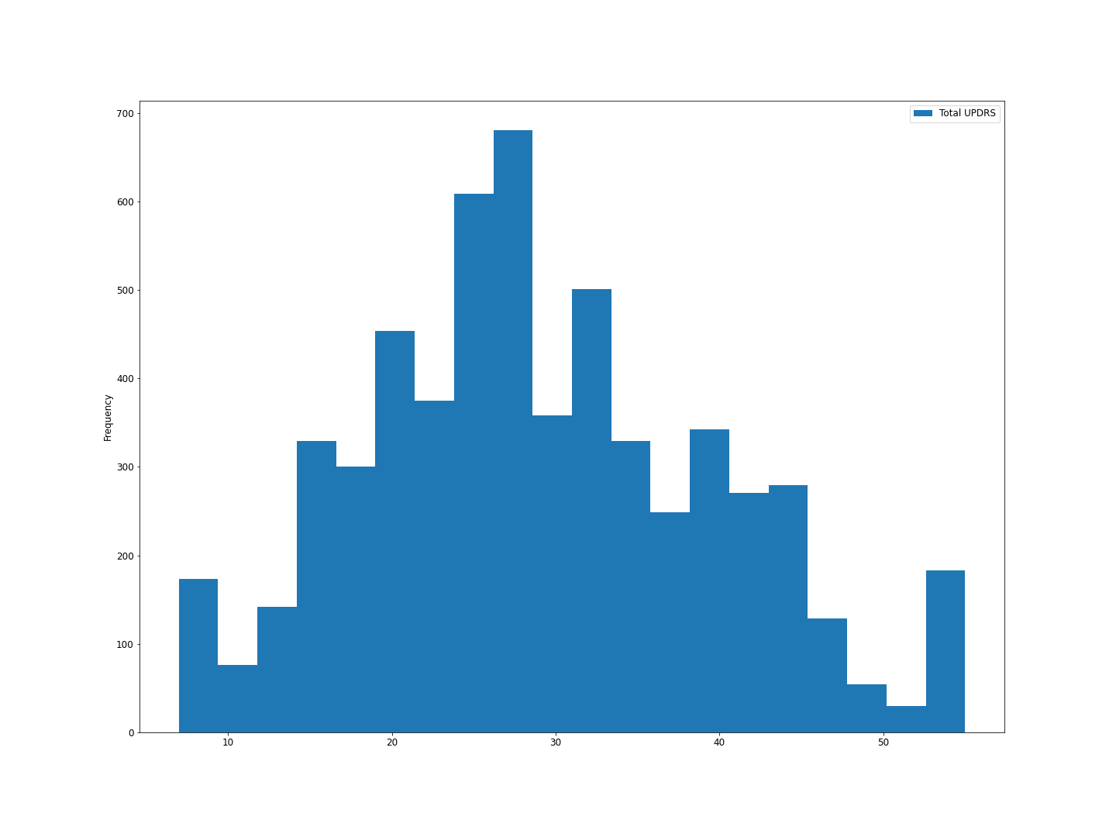
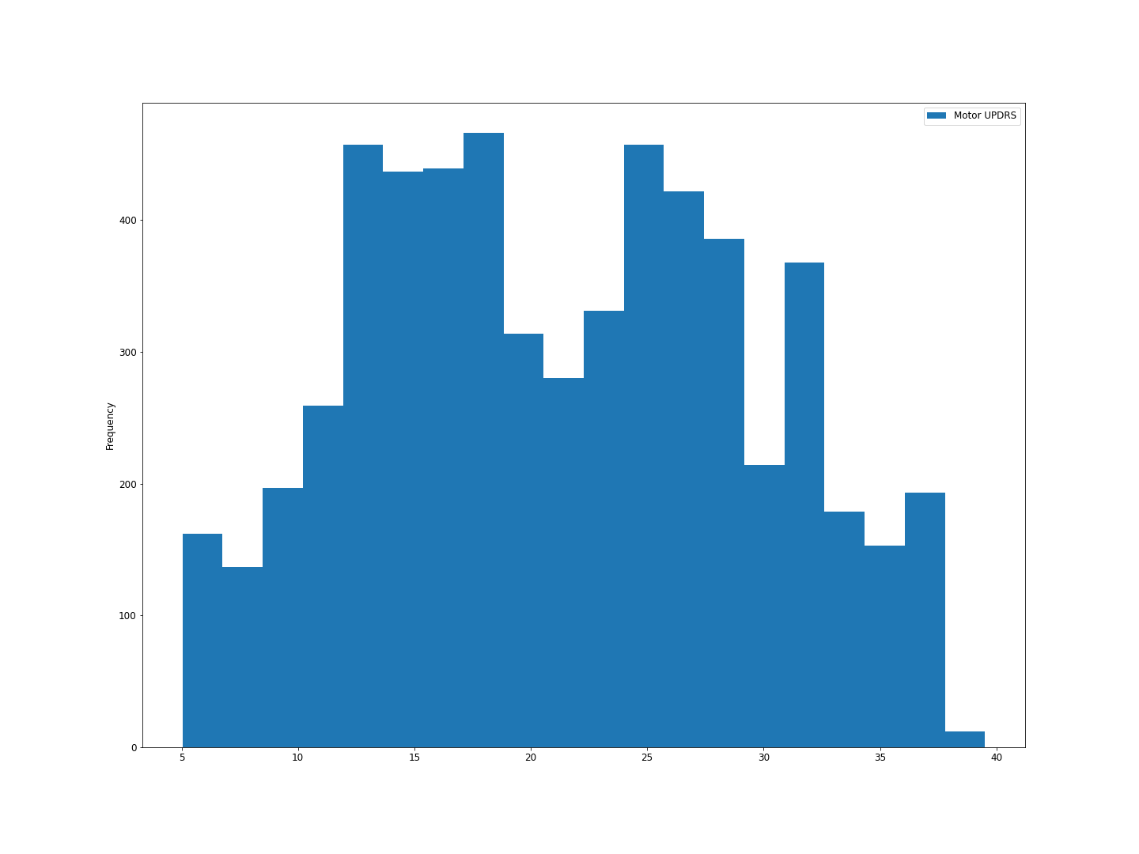
Distribution of Total and Motor UPDRS

Slide 14
04
Modeling
How did we implement?

Slide 15
Feature Selection
F- Test
Mutual
Information
PCA
RFE
Feature Selection using univariate regression
Mutual Information Feature Selection
Principal Component Analysis
Recursive Feature Elimination

Slide 16
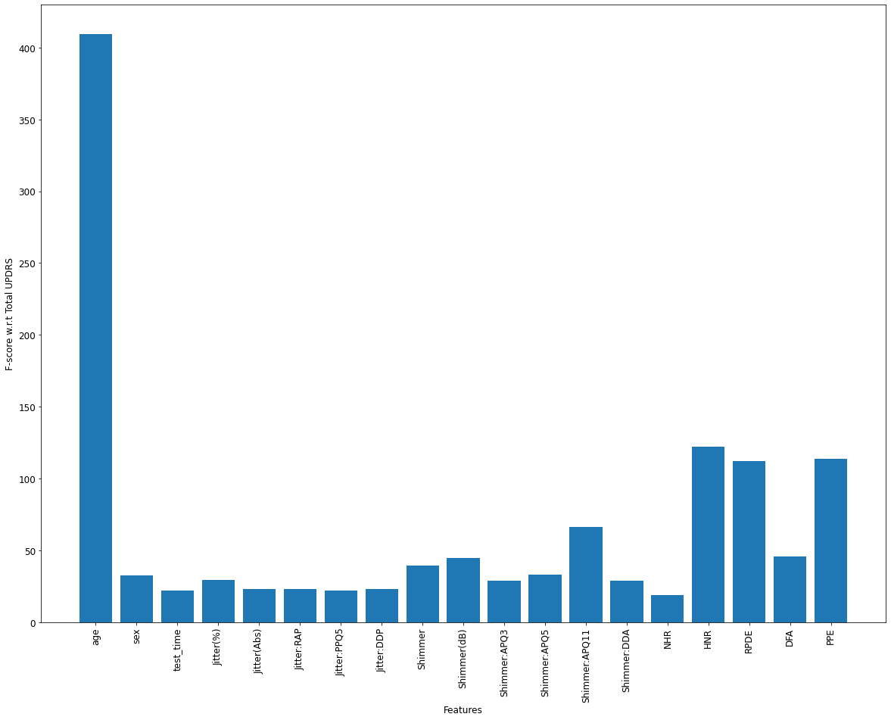
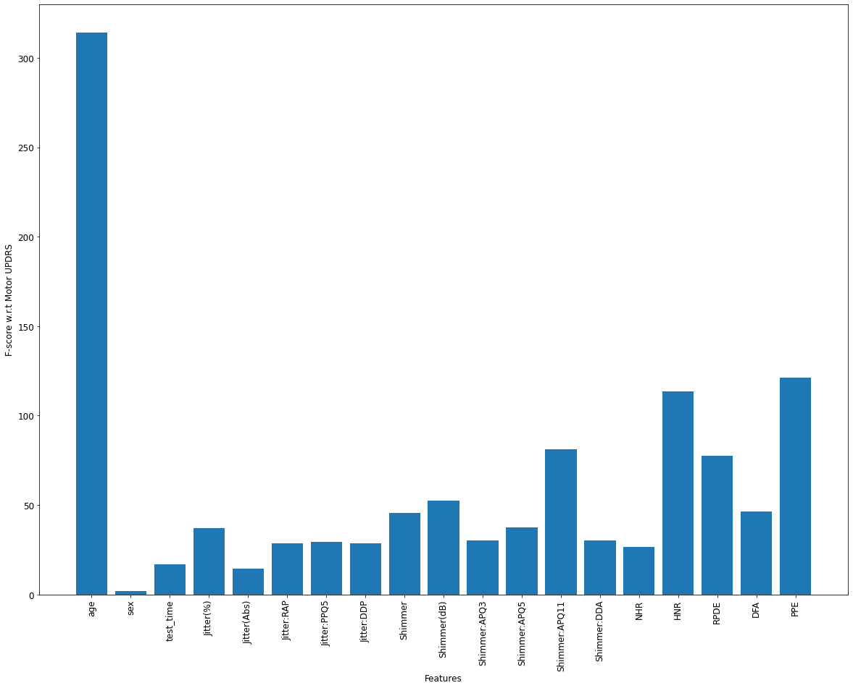
F- Test

Slide 17
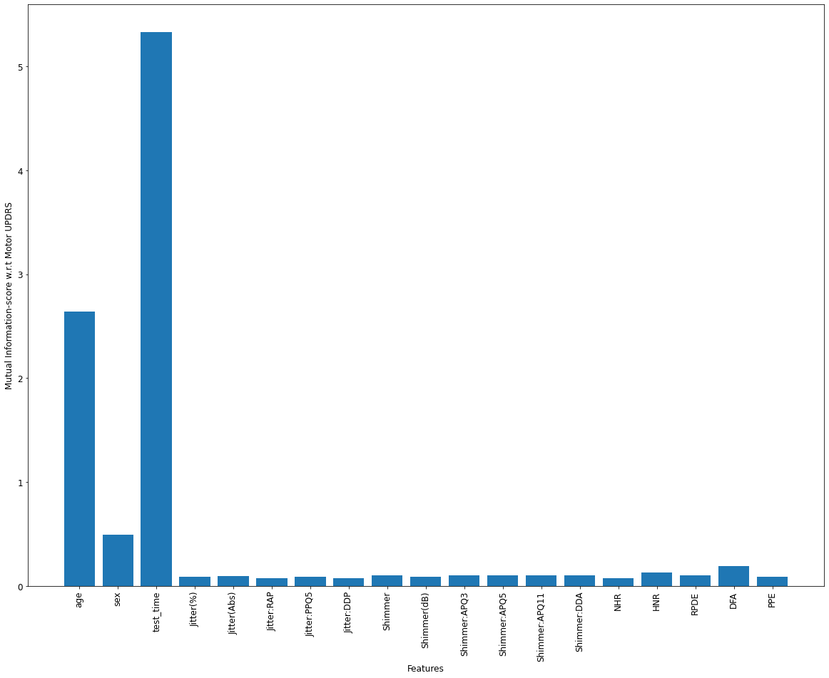
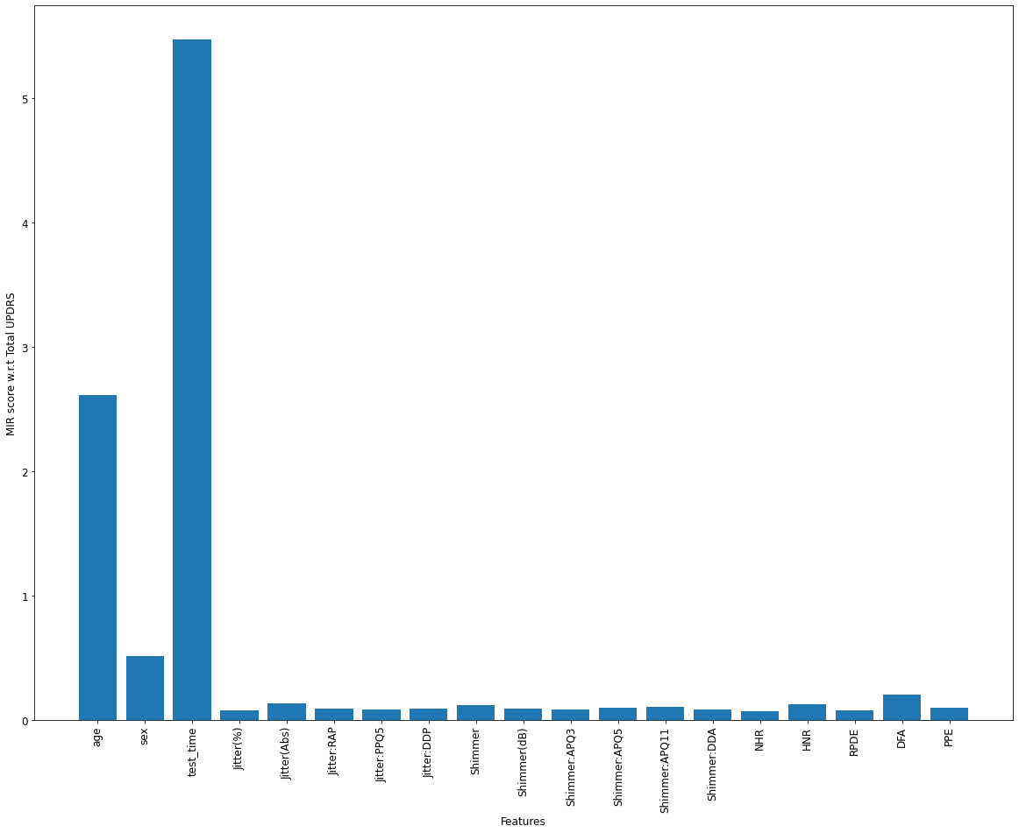
Mutual Information Feature

Slide 18
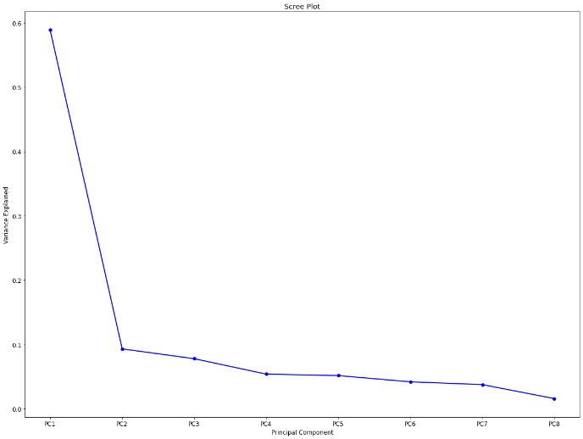
Recursive Feature Elimination
Age
Gender
Test Time
Jitter(Abs)
Shimmer:APQ5
HNR
RPDE
DFA
PPE
Principal Component Analysis

Slide 19
Machine Learning Models Used
01
02
03
04
06
Linear
Regression
Lasso
Ridge
ElasticNet
Gradient
Boosting
Extra
Trees
Decision
Tree
Random Forest
SVR
05
07
08
09

Slide 20
Results
The most awaiting moment.

Slide 21
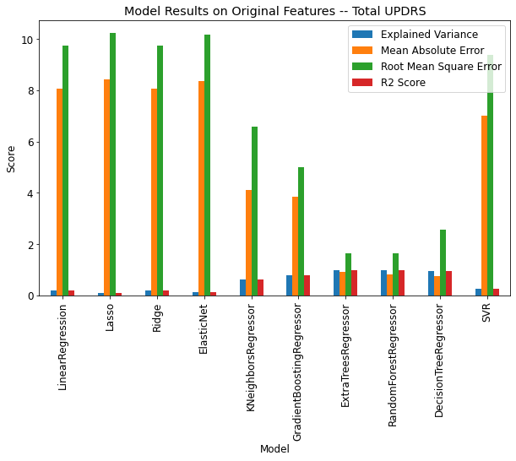
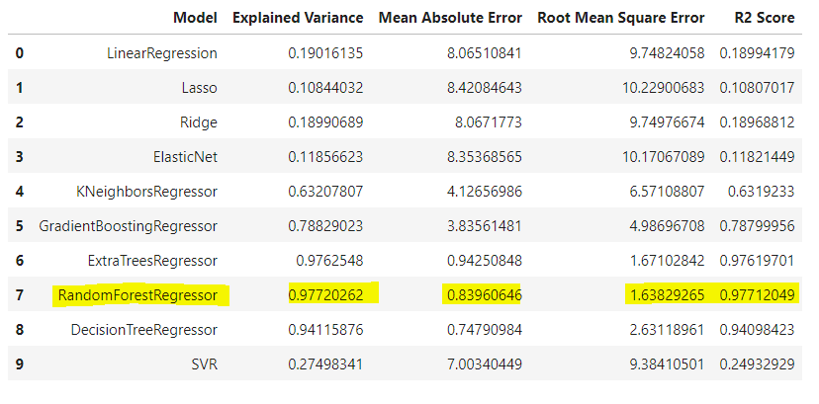
Original Features – Total UPDRS

Slide 22
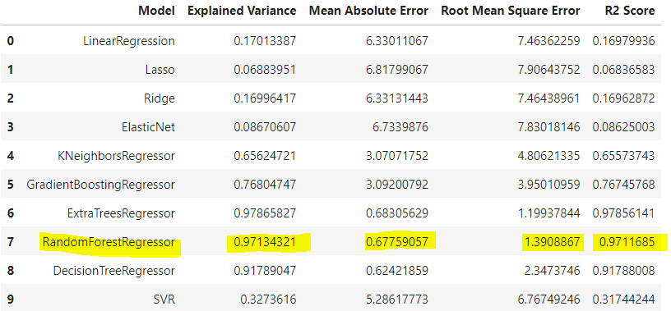
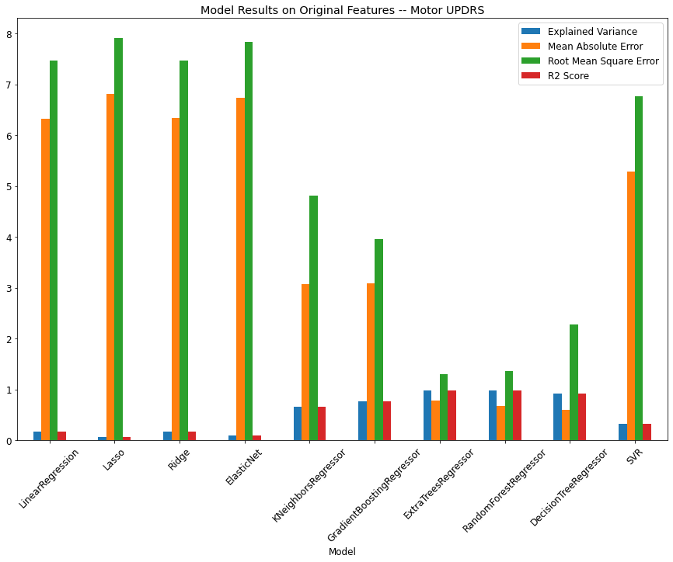
Original Features – Motor UPDRS

Slide 23
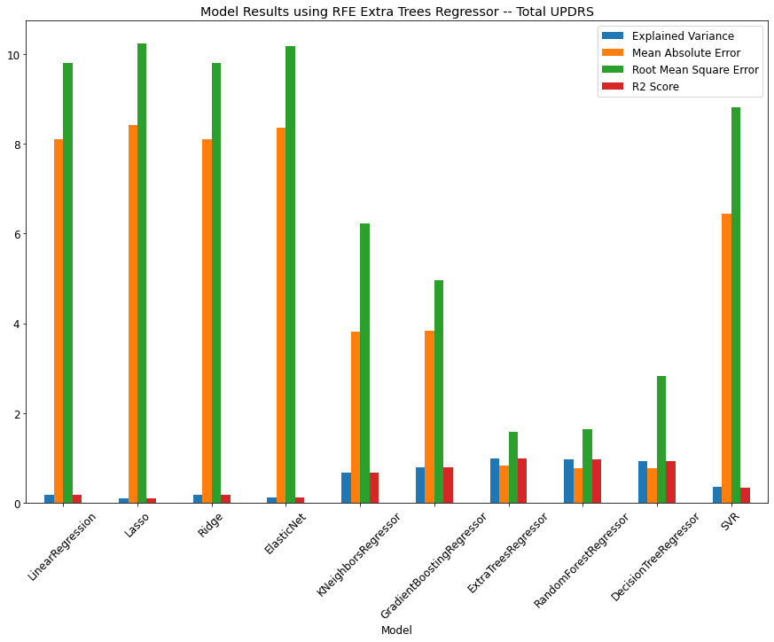
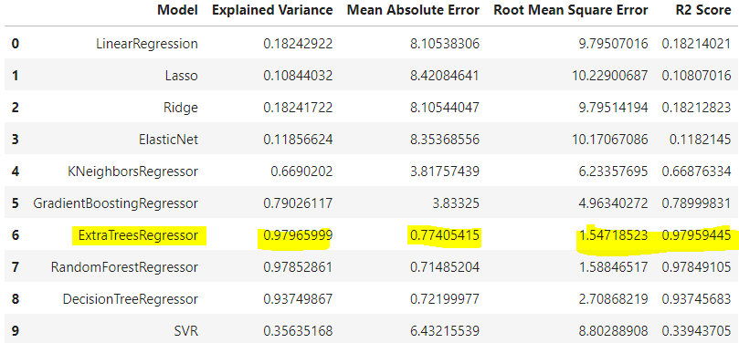
Using RFE Extra Tree – Total UPDRS

Slide 24
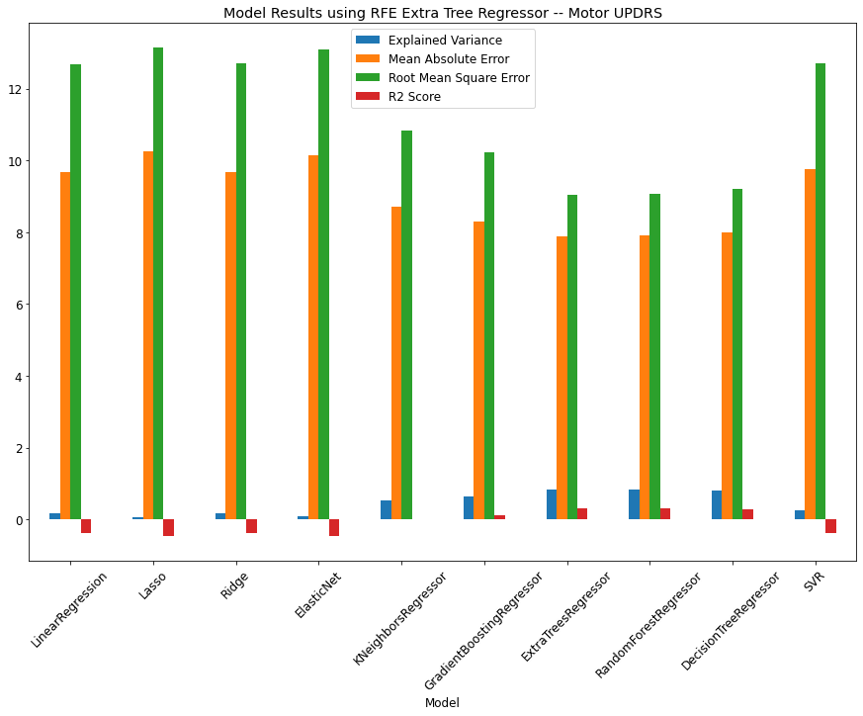
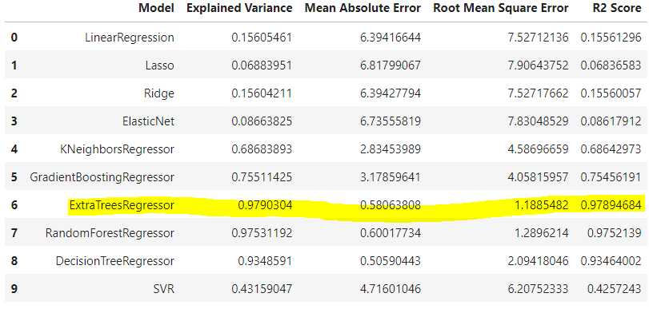
Using RFE Extra Tree – Motor UPDRS
RandomForestRegressor and ExtraTreesRegressor outperformed other models

Slide 25
References
Little MA, McSharry PE, Hunter EJ, Ramig LO (2009), 'Suitability of dysphonia measurements for telemonitoring of Parkinson's disease’, IEEE Transactions on Biomedical Engineering, 56(4):1015-1022AUTHOR (YEAR). Title of the publication. Publisher
Tsanas A, Little MA, McSharry PE, Ramig LO. Accurate telemonitoring of Parkinson's disease progression by non-invasive speech tests. IEEE Trans Biomed Eng. 2010 Apr;57(4):884-93. doi: 10.1109/TBME.2009.2036000. Epub 2009 Nov 20. PMID: 19932995.
Accurate telemonitoring of Parkinson.s disease progression by non-invasive speech tests', IEEE Transactions on Biomedical Engineering (to appear).

Slide 26
Thank You!

